Slide 1
The Role of Integrity in Attestation and Isolation
Luca Wilke
Based on papers “SEVurity” and “undeSErved trust”
which are joint work with:
Jan Wichelmann, Florian Sieck, Mathias Morbitzer and Thomas Eisenbarth
Wilke,Wichelmann,Sieck,Eisenbarth, “undeSErVed trust: Exploiting Permutation-Agnostic Remote Attestation”, WOOT2021 Wilke,Wichelmann,Morbitzer,Eisenbarth, “SEVurity: No Security Without Integrity: Breaking Integrity-Free Memory Encryption with Minimal Assumptions.", 2020 IEEE Symposium on Security and Privacy (SP)

Slide 2
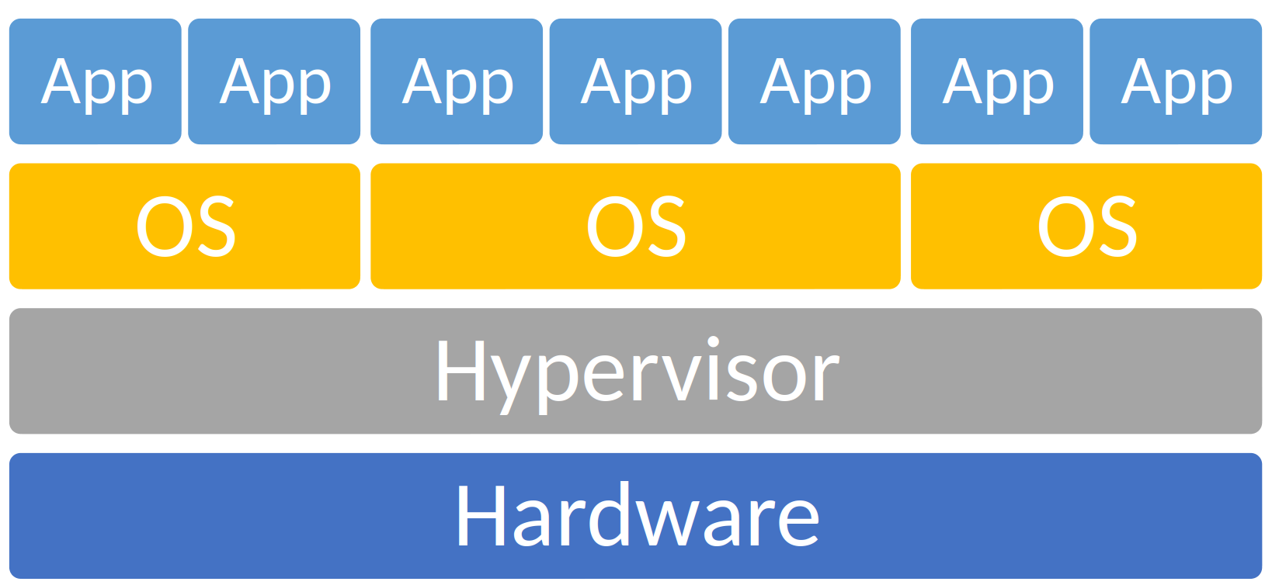
Cloud Computing & Complex Software Stacks
Cloud Computing
requires trust in Hypervisor
shared resources between guests
⇒ TEEs can remove trust from Hypervisor
Complex Software Stacks
large attack surface
⇒ TEEs allow isolated “trust bubbles”
Attack
Attack
Attack

Slide 3
Trusted Execution Environments
TEE
Attestation of Content
Isolation at Runtime

Slide 4
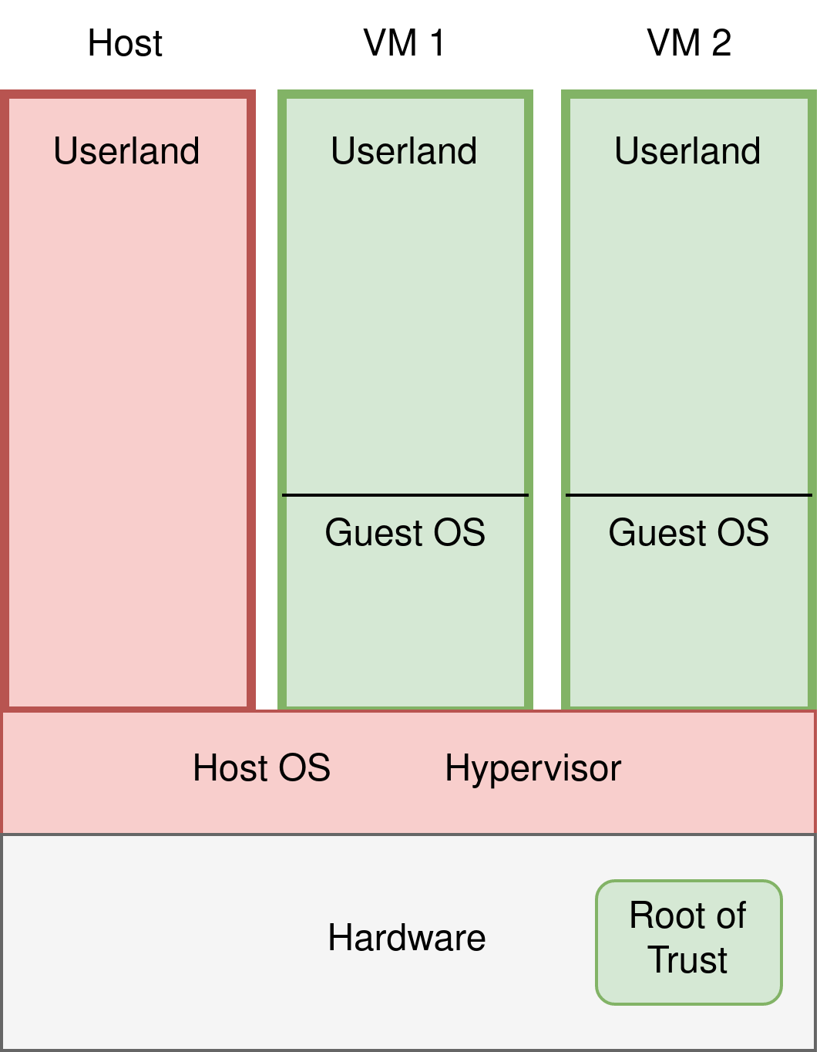
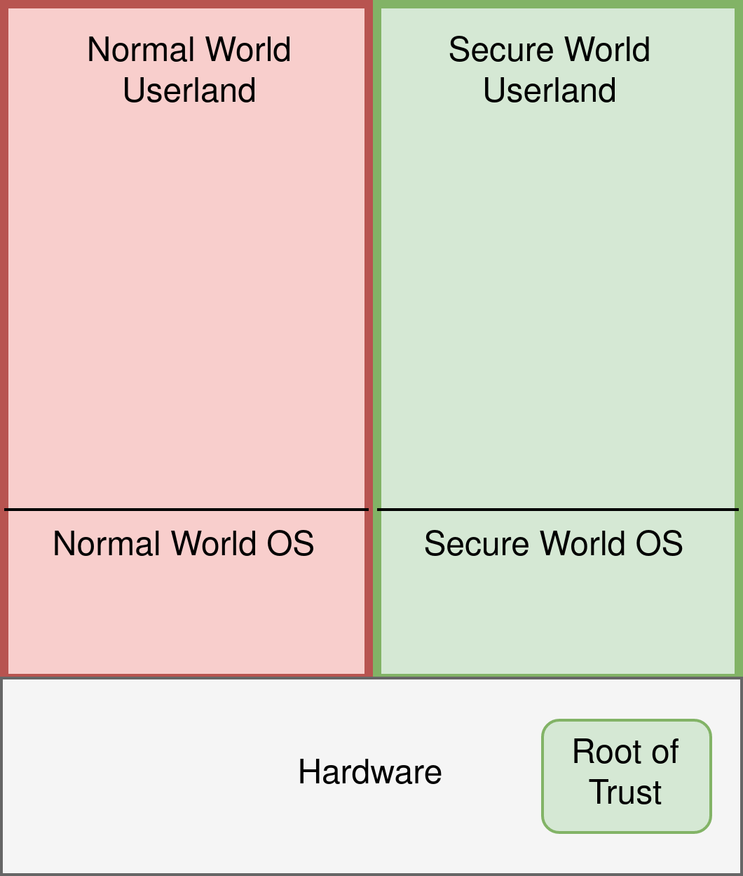
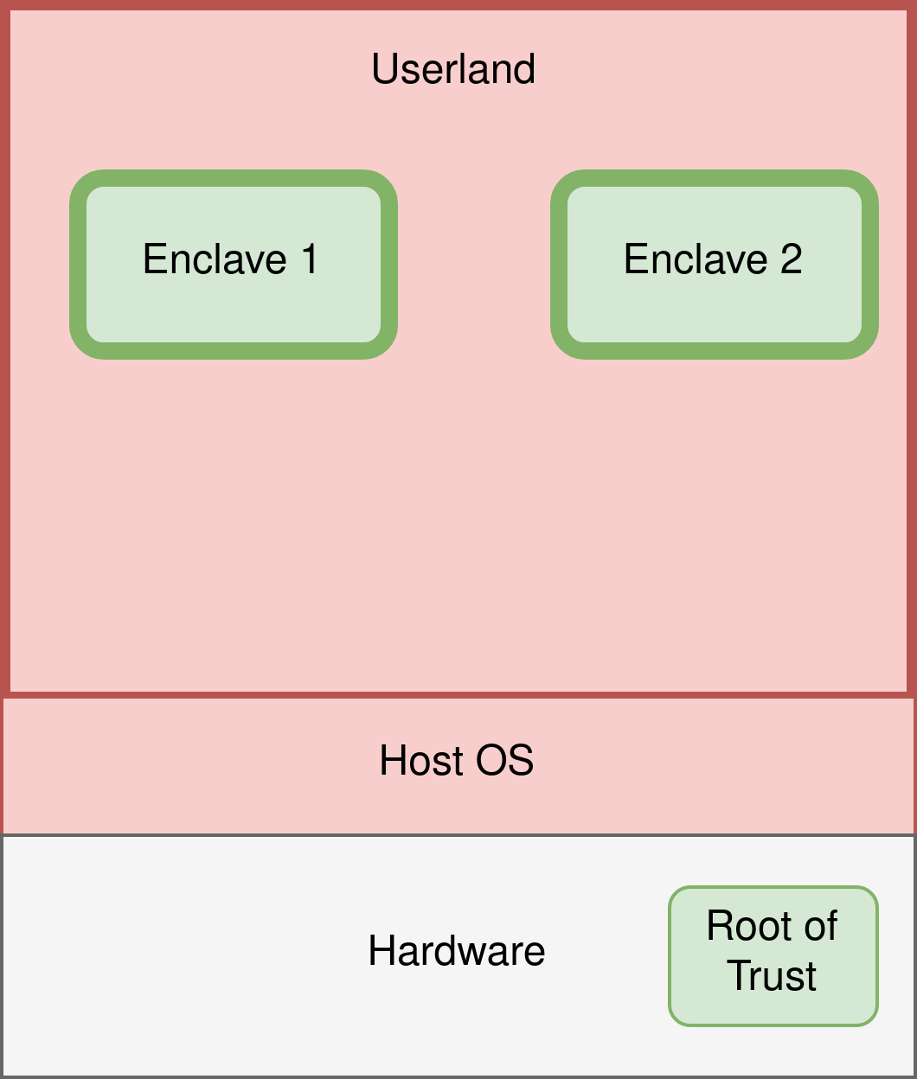
Comercial TEEs
ARM Trustzone
Intel SGX
AMD SEV
Notes:
only commercial solutions, there are also the academic RiscV ones

Slide 5
Attack
on SEV’s Attestation

Slide 6
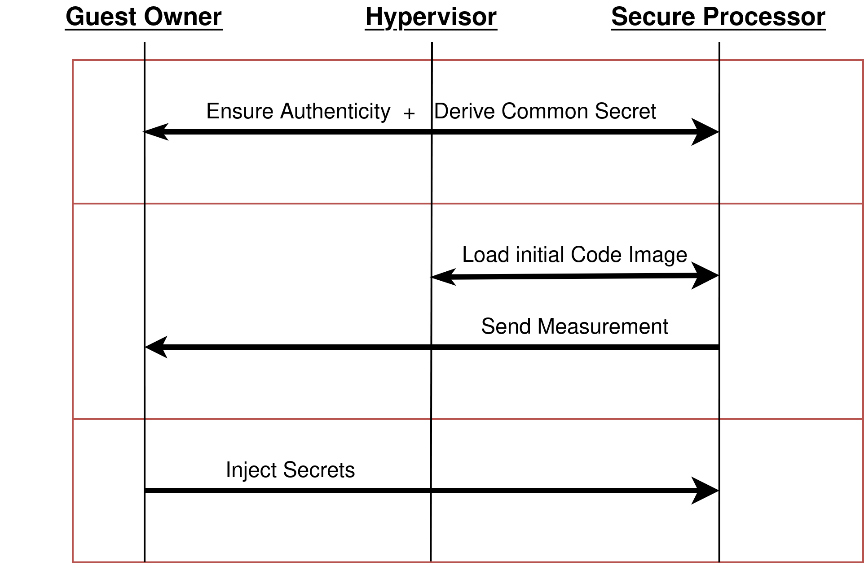
Attestation Protocol

Slide 7
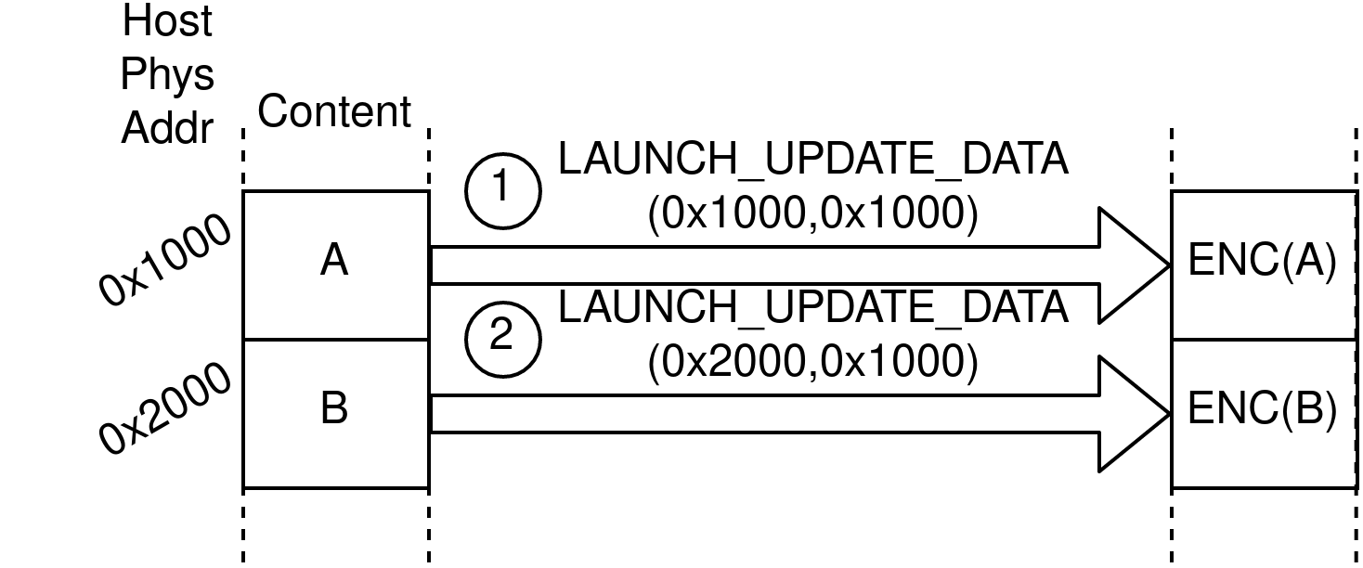
Loading initial code image
Hash State = 丄
Hash State = A
Hash State = A,B
Measurement=HMAC(...,Finalize(Hash State);Key)

Slide 8
Loading initial code image
Run 1
Run 2
Hash State = ⊥
Hash State = A,B
Hash State = ⊥
Hash State = A,B
Measurement=HMAC(...,Finalize(Hash State);Key)
Measurement=HMAC(...,Finalize(Hash State);Key)
Different VM content, same measurement!
“Block” granularity is as low as 16 bytes

Slide 9
Exploit

Slide 10
Example: Breaking a Password Check
...if( suppliedPw != correctPW ) { … abort(); … } ...
Original Code
Manipulated Code

Slide 11
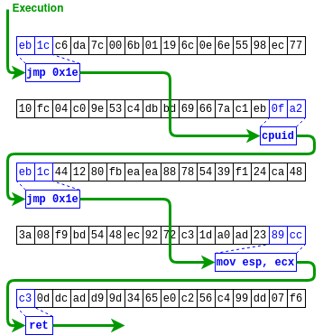
Bootstrap Encryption/Decryption Oracles
Reorder code blocks without changing attestation
Malicious Gadget maps VM’s stack to an unencrypted page
Hypervisor writes ROP addresses and payload code onto VM’s stack
ROP gadgets moves payload to private page and executes it
“Blockchain” produced by reordering the memory blocks
Encryption/Decryption
Code Execution

Slide 12
Case Study : Stealing Disk Encryption Keys
Initialization of VM
Scenario
SEV only protects RAM; Disk Encryption is done in SW
Secure Processor has API to securely load secrets into VM’s RAM
Attack
Use ROP gadget to move secret from encrypted memory to unencrypted memory
UEFI
Protected by Attestation
Bootloader
Protected by Attestation
Loaded from
Encrypted Disk
OS

Slide 13
Mitigations
CVE-2021-26311
SEV(-ES):
Increase minimal code block size in launch command
Include addresses of blocks in measurement
Neither can fully fix the problem due to untrusted Nested Page Tables
SEV(-SNP)
Nested Page Tables problem fixed
Attestation protocol has larger block sizes and includes addresses

Slide 14
Attack on SEV’s Isolation

Slide 15
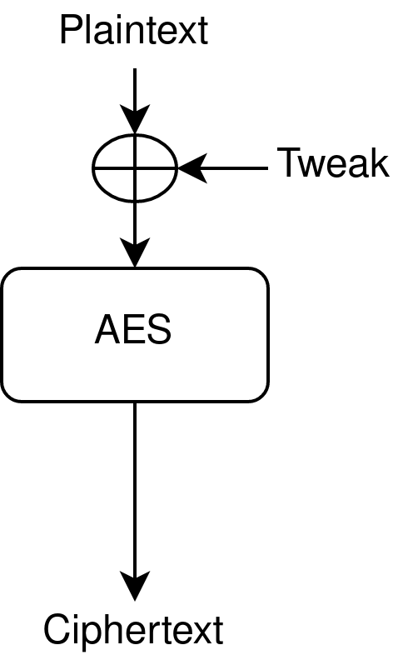
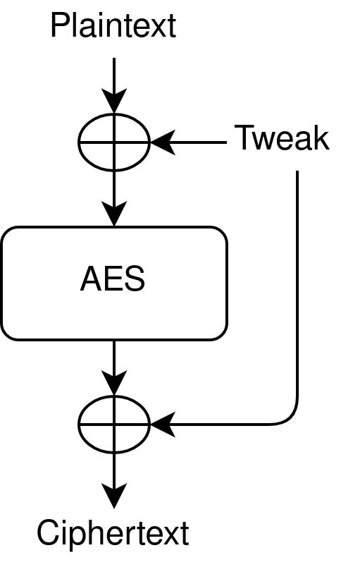
Encryption Mode
Old Mode [DYM+]
Updated Mode
SEVurity
Tweaks
VM independent
Linear function of physical address
[DYM+] Z.-H. Du, Z. Ying, Z. Ma, Y. Mai, P. Wang, J. Liu, and J. Fang, “Secure encrypted virtualization is unsecure,” arXiv preprint arXiv:1712.05090, 2017

Slide 16
Tweaks
Tweak constant | Value (16 Byte)
t₂ | 82 25 38 38 ....
t₅ | ec 09 9c ec ...
... | ...
t₁₂ | b0 92 30 c2 ...
... | ...
Zen 1, Zen 1 Embedded
Low entropy, static tweaks
Reverse engineered
Zen 2, (Zen 3?)
High entropy tweaks
Per boot randomness in tweaks
Tweaks unknown
Tweak(0x1000) = t₁₂
Tweak(0x1010) = t₁₂ ⊕ t₄

Slide 17
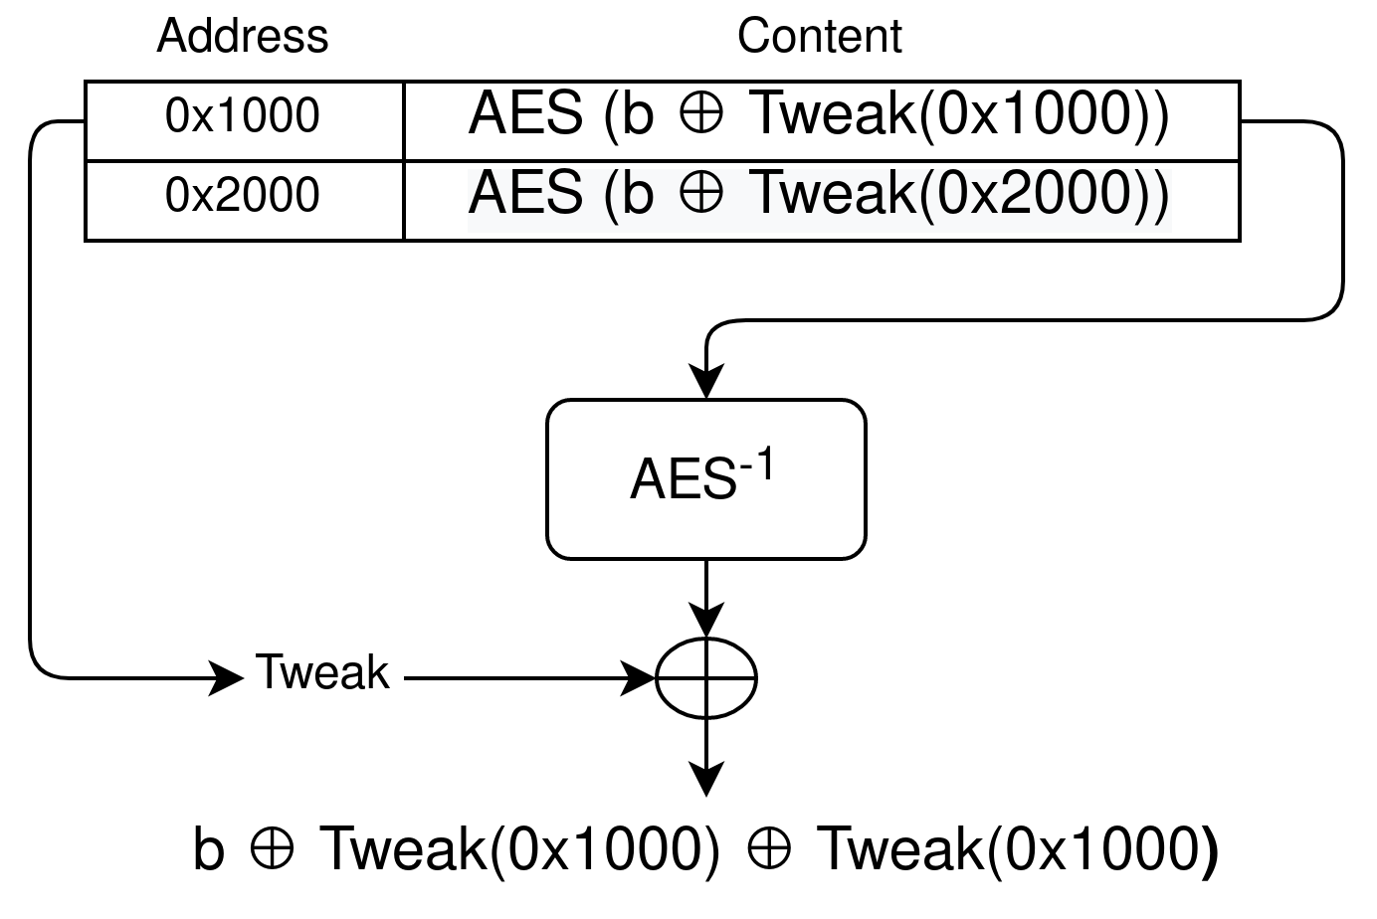
Cipherblock Moving Attack

Slide 18
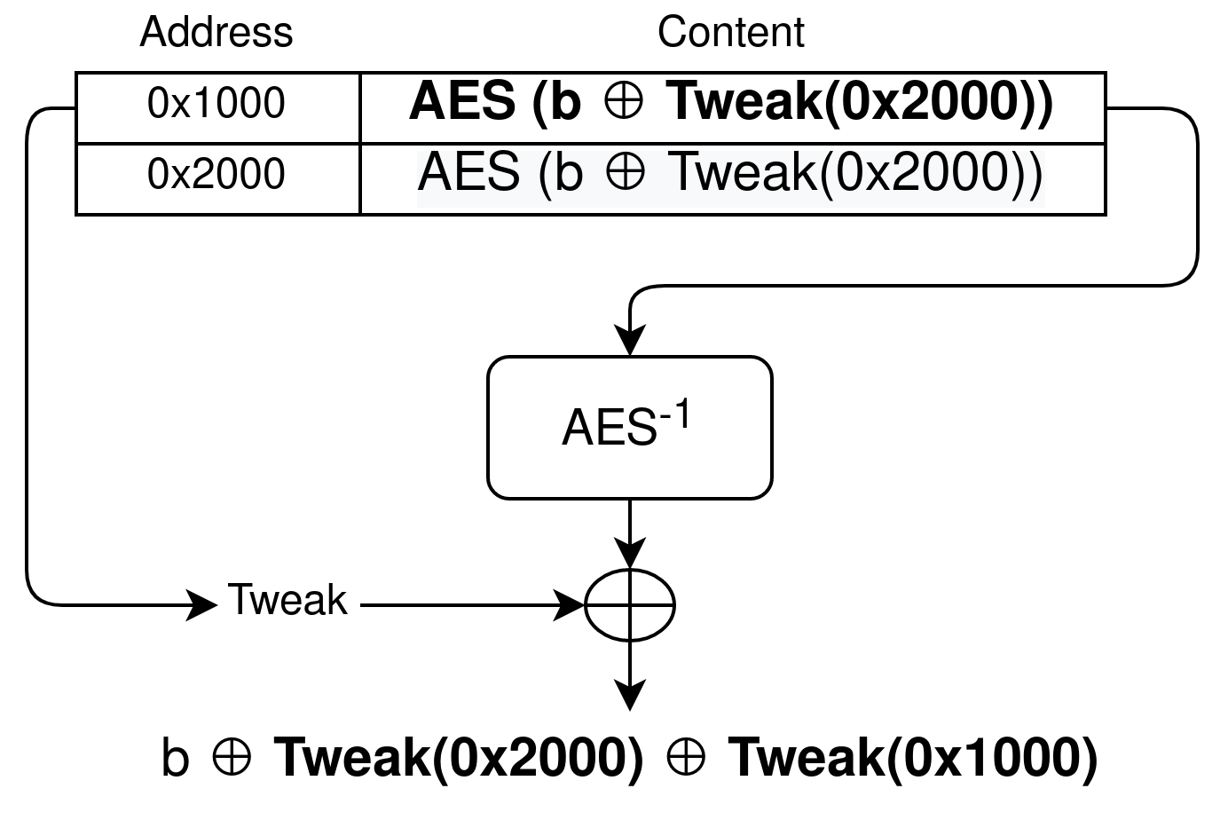
Cipherblock Moving Attack

Slide 19
Exploit
Using the guest kernel as a known plaintext source gives us control over 2 bytes
Upper limit is 4 bytes, due to tweak periodicity
Same exploit strategy as with attestation attack possible
Can use blocks more than once
Can alter memory layout on the fly
Moving ciphertext block changes its plaintext

Slide 20
Mitigations
Zen 2 CPUs have high entropy tweaks
SEV-SNP (Zen 3) prohibits Hypervisor from writing to VM memory

Slide 21
Conclusion

Slide 22
Summary
Reordering 16 byte code blocks allows construction of powerful malicious gadgets
Two attack vectors
Attestation of SEV(-ES) does not detect permutations
Zen 1: XEX Cryptosystem with weak tweaks allows to move code blocks
Both attacks mitigated with SEV-SNP (Zen 3)
@lucawilkeUzL
@JanWichelmann
@tomcrypt
@Florian_UzL_ITS
uzl-its.github.io/undeserved-trust/
uzl-its.github.io/SEVurity/

Slide 23
Slide Archive

Slide 24
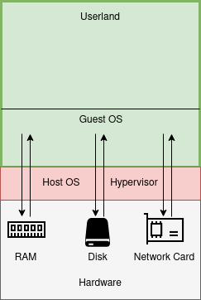
SEV Scenario
Notes:
explain trust
explain i/o interaction

Slide 25
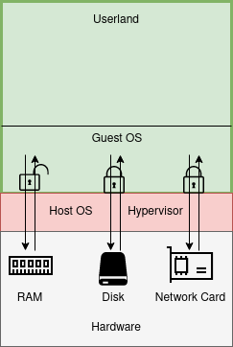
SEV Scenario
Notes:
explain how to secure all but ram
transition ram protected by sev

Slide 26
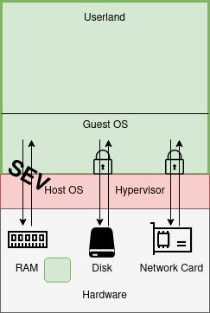
SEV Scenario
Notes:
transi

Slide 27
Bootstrap Encryption/Decryption Oracles
Read/Write Arbitrary Data
Execute Arbitrary Code
Case Study: Steal Disk Encryption Keys
“Blockchain” produced by reordering the memory blocks

Slide 28
Exploit
Same exploits as with attestation attack possible
Even more control, as we can
use blocks more than once
rewrite injected code on the fly

Slide 29
Case Study : Stealing Disk Encryption Keys
Initialization of VM
Scenario
SEV only protects RAM; Disk Encryption is done in SW
Secure Processor has API to securely load secrets into VM’s RAM
Attack
Use ROP gadget to move secret from encrypted memory to unencrypted memory
UEFI
Protected by Attestation
Bootloader
Protected by Attestation
Protected by
Disk Encryption
OS

Slide 30
Creating SEV VMs : Boot Sequence
vCPU jumps to Reset Vector
configures CPU
Initialization of VM
UEFI
Bootloader
OS

Slide 31
Countermeasures
SEV(-ES)
Increase minimal size limit for measured blocks during launch
Makes exploitation harder
Limited to 4096 byte blocks (one page) due to page remapping flaw
Include addresses of blocks in measurement
Can ensure order inside a page but not beyond due to page remapping flaw
SEV(-SNP)
Page remapping flaw is resolved
Block size is increased to 4096 bytes (page)
Addresses included in measurement

Slide 32
Responsible Disclosure
Disclosed to AMD on January 19th, 2021
Embargo until May 11, 2021
Mitigation with SEV-SNP on 3rd Gen EPYC
CVE-2021-26311

Slide 33
Exploiting Control Over Blocks v1
Reorder initial VM image to create a malicious code gadget
Measure and start VM, Owner cannot detect malicious gadget
Problems:
Does not scale well
Block availability might vary
“Blockchain” produced by reordering the memory blocks

Slide 34
Exploiting Control Over Blocks v2
Reorder initial VM image to create a malicious code gadget
Measure and start VM, Owner cannot detect malicious gadget
Malicious Gadget maps some VM page as unencrypted and jumps to it
Hypervisor fills page with attack code before jump
Does not work: Code fetch always considers page as encrypted
“Blockchain” produced by reordering the memory blocks

Slide 35
Case Study : Stealing Disk Encryption Keys
Scenario
SEV only protects RAM; Disk Encryption is done in SW
Secure Processor has API to securely load secrets in VM RAM
Attack
Use ROP gadget to move secret from encrypted memory to unencrypted memory

Slide 36
ROADMAP
Understand flaw in SEV (-ES) attestation
Exploit-Chain for Arbitrary Code execution

Slide 37
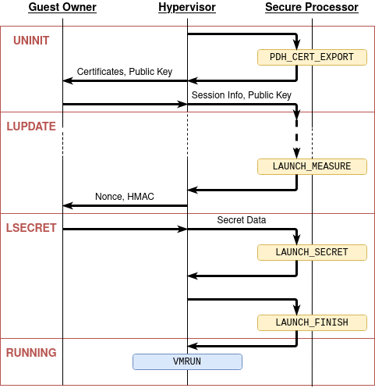
Creating SEV VMs : Launch Secrets
Derive two keys, TEK and TIK, via DH Key-Exchange.
HMAC is keyed with TIK -> Guest Owner can verify
Guest Owner encrypts+Integrity protects Secret Data with TIK and TEK
Secure Processor stores Secrets in VM RAM

